Slide 1
Certificate Formats

Slide 2
Certificate File Formats
X.509 digital certificates
Structure of certificate is standardized
Format of actual certificate file can take many forms
Many certificate file formats
Possible to convert from one format to another

Slide 3
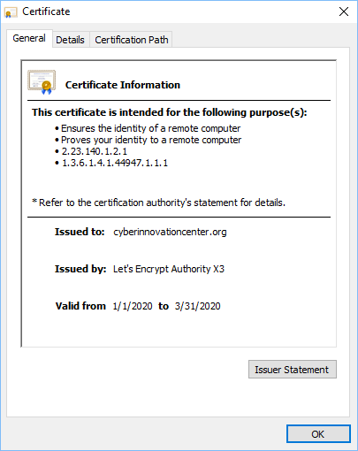
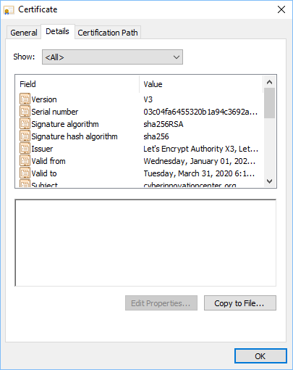
Certificate contents

Slide 4
Privacy-Enhanced Mail format (.pem)
Supported on most platforms
Generally the format provided by CAs
ASCII format
Letters and numbers
Easy to email
Human-readable

Slide 5
PKCS #12 (.p12)
Public Key Cryptography Standards #12
Personal Information Exchange Syntax Standard
Developed by RSA Security
Now RFC Standard
Container format for many certificates
Store many X.509 certificates in a single .p12 file
Often used to transfer key pairs
Password protection
Extended from Microsoft’s .pfx format
Very similar

Slide 6
PKCS #7 (.p7b)
Public Key Cryptography Standards #7
Cryptographic Message Syntax Standard
Associated with the .p7b file
ASCII format
Human-readable
Contains certificates and chain certificates
Private keys not included in .p7b file
Supported on most platforms

Slide 7
Certificate format (.cer)
Primarily a Windows X.509 file extension
Encoded as binary DER format or ASCII PEM format
Contains a public key
Private keys transferred in .pfx file format
Common for Windows

